Slide 1
Life Expectancy Report
Team 4: Bin Xu, Di Kang, Jiahua Zhang, Yiwei Zhang

Slide 2
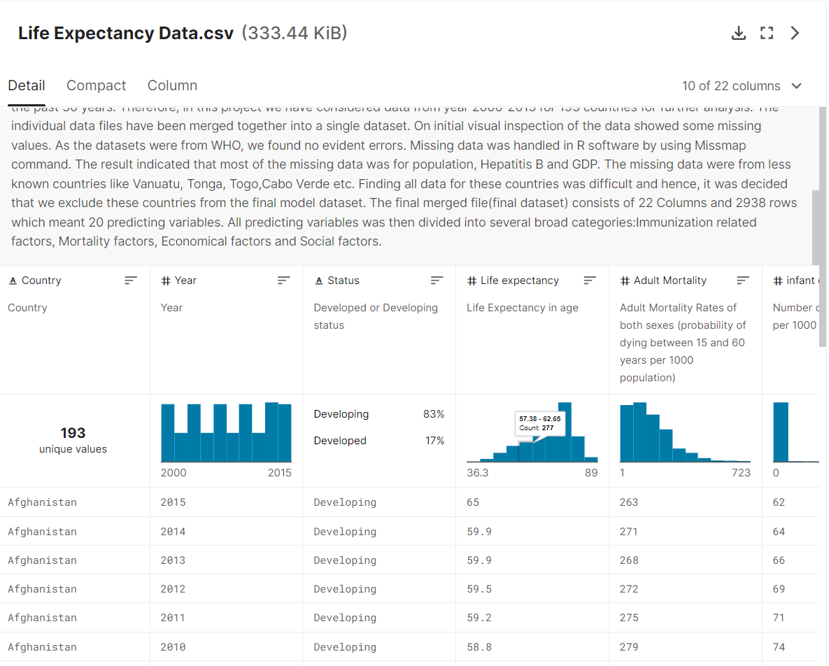
Data from Kaggle

Slide 3

Approach
A random forest regressor trained on the life expectancy dataset provided via Kaggle
We combine the low bias and high variance trait of decision trees, merge a “forest” of trees to arrive at a more desired outcome.
Through visualizing each individual decision tree, we can somewhat reason why the model decided on the decision that was outputted.
Elevate each individual parameter by a percentage and seeing how much that would impact the life expectancy prediction outcome.
Notes:
Nonlinear:
10 dollars in a needy family
1 million for a billionaire

Slide 4
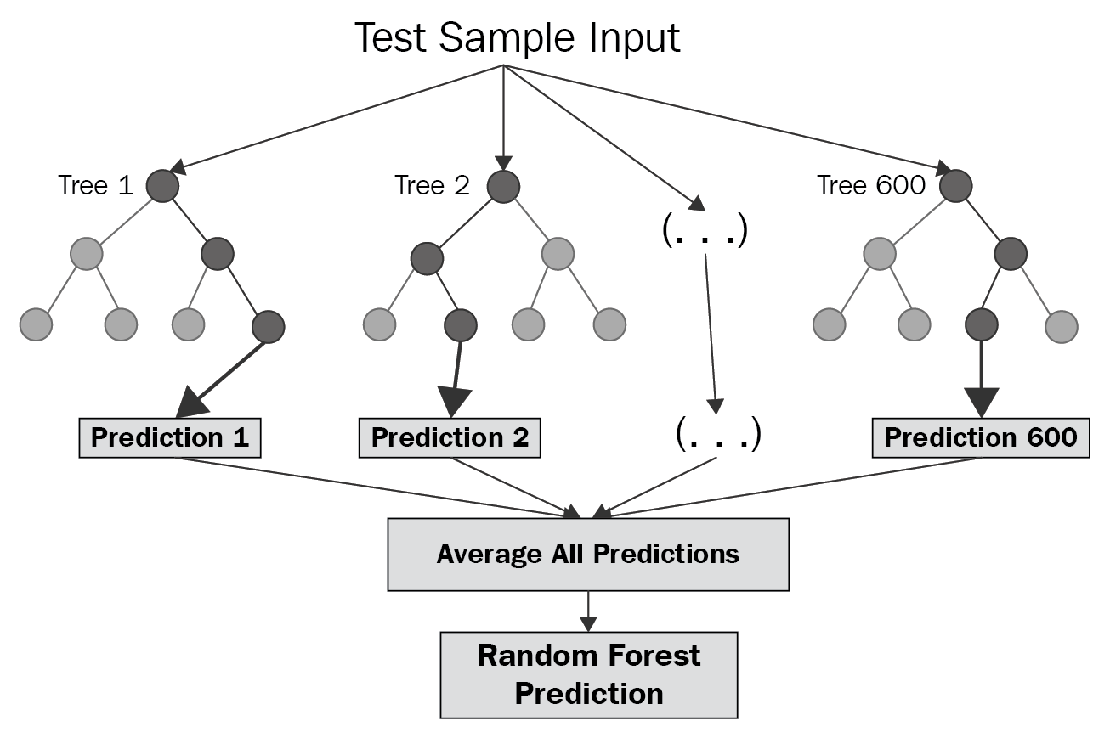
Random Forest

Slide 5
Random Forest regression advantage:
1.prefer for nonlinear or complex relationships between elements and labels.
2.It is not sensitive to the noise of training concentration

Slide 6
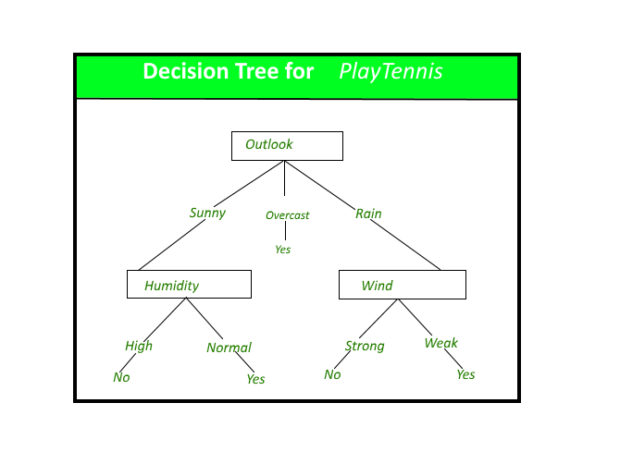
Decision Tree

Slide 7
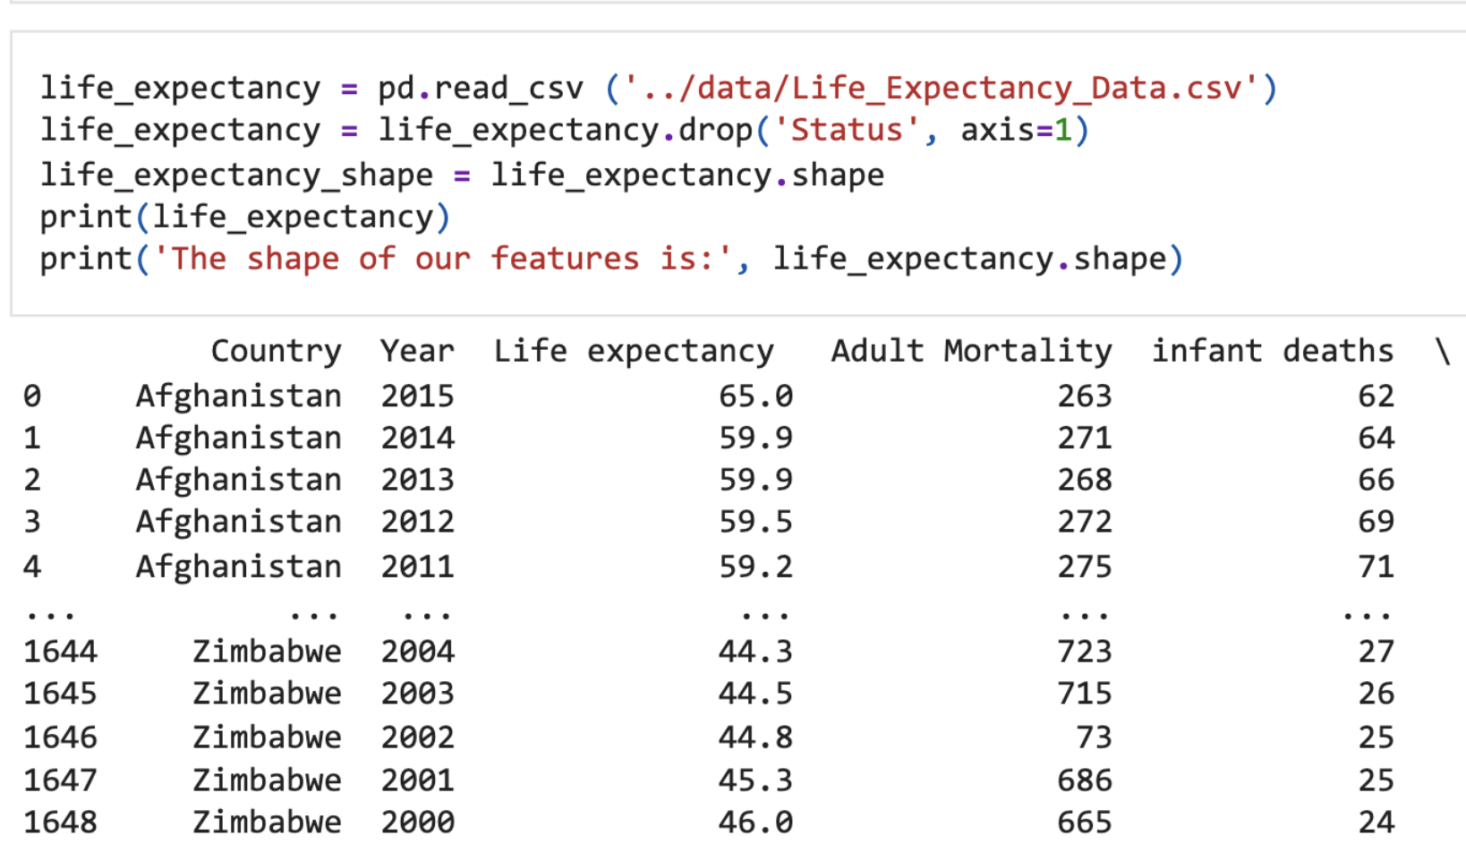
Processing Data

Slide 8
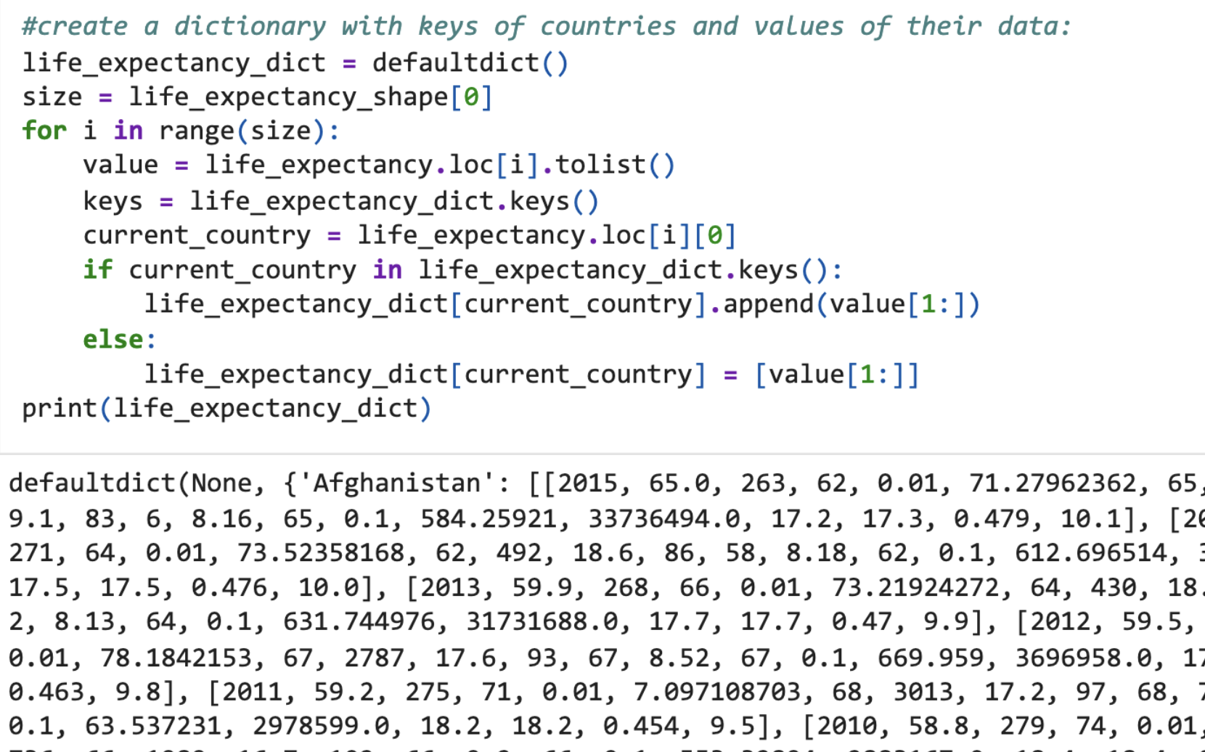
create a map to store the data, set country as key, and related data as value

Slide 9
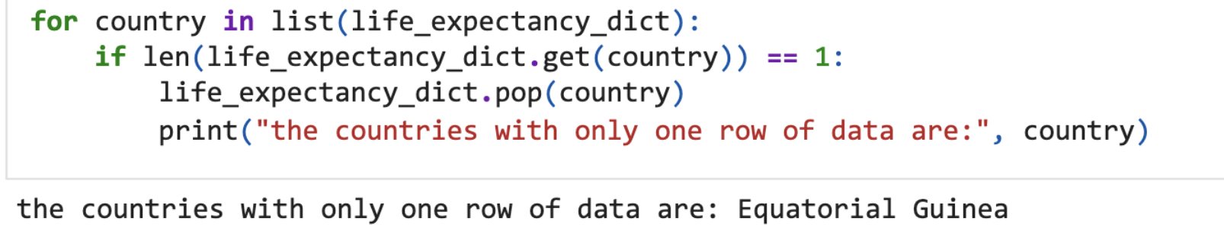
delete the exception data, we find there are two countries with only one row

Slide 10
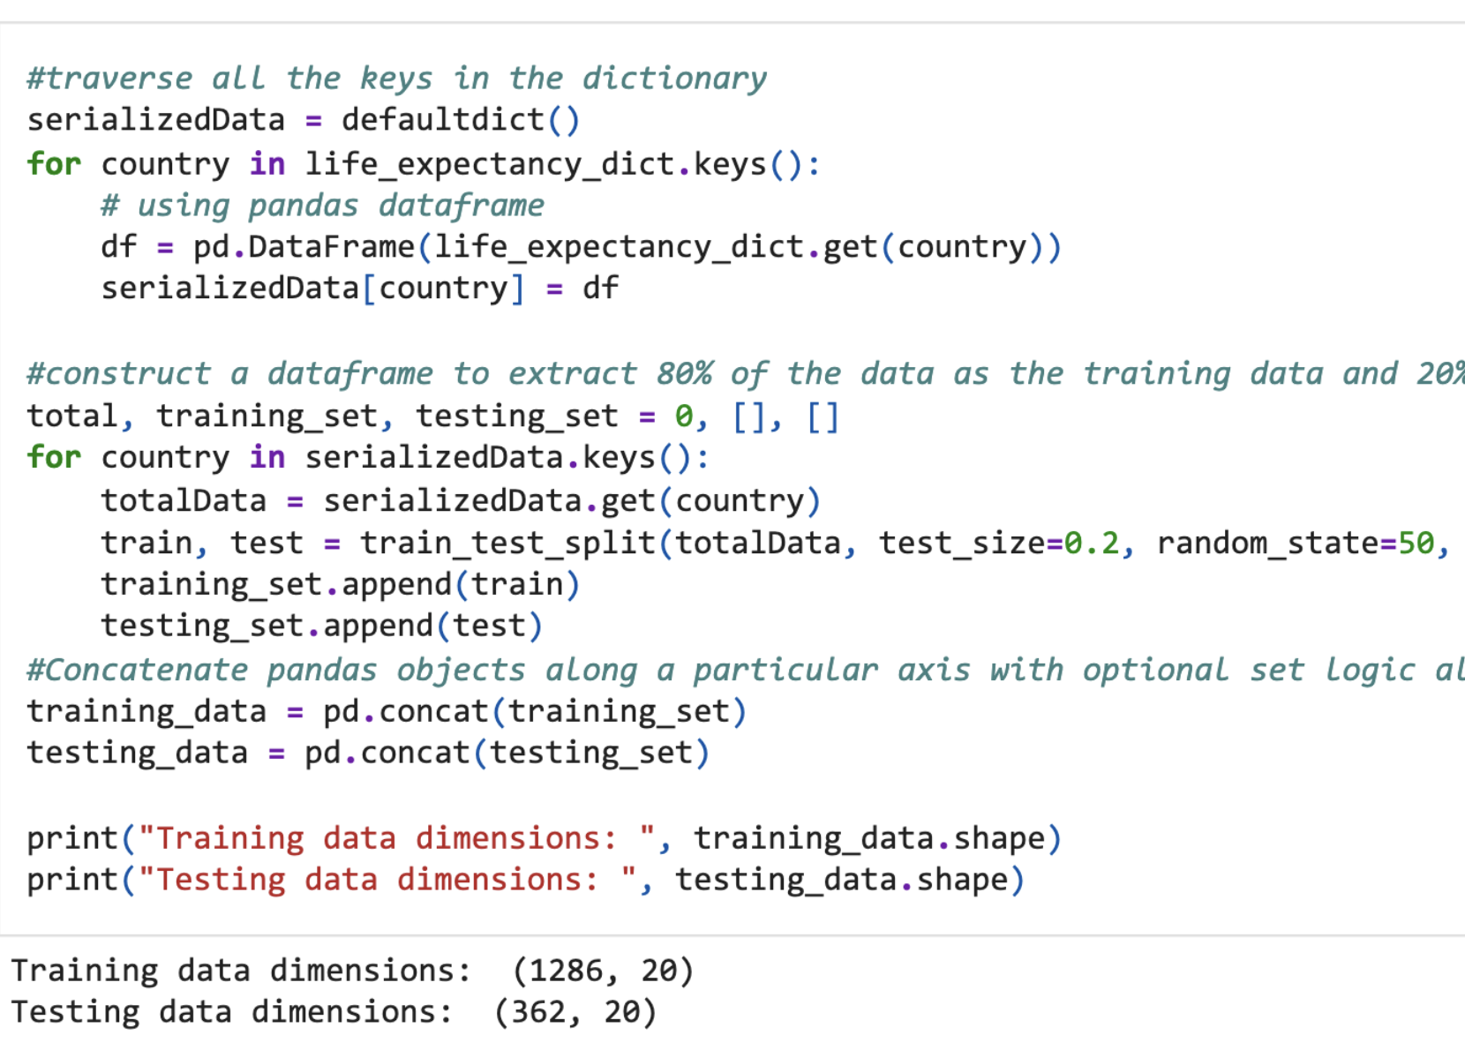
Set up test set and training set, 80% for testing, 20% for trainning

Slide 11
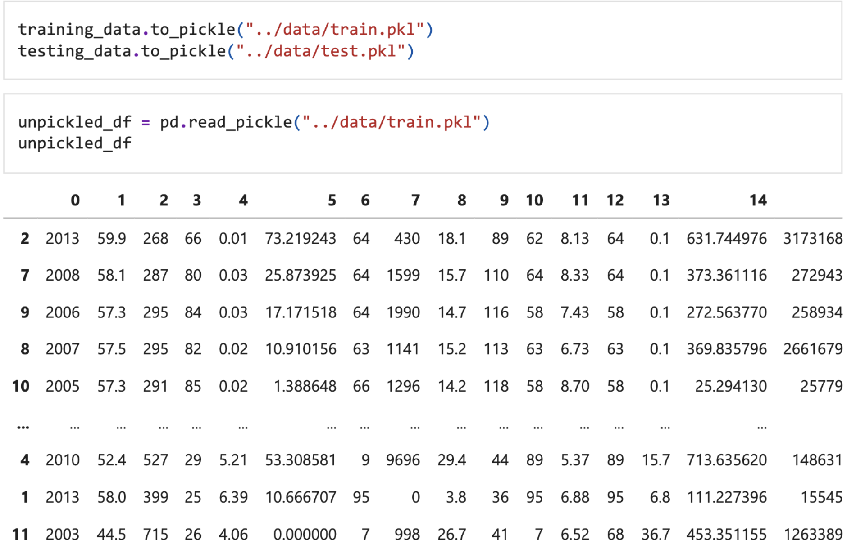
we transfer the filtered training and testing data to pickle file, it is a way to serialize then data

Slide 12
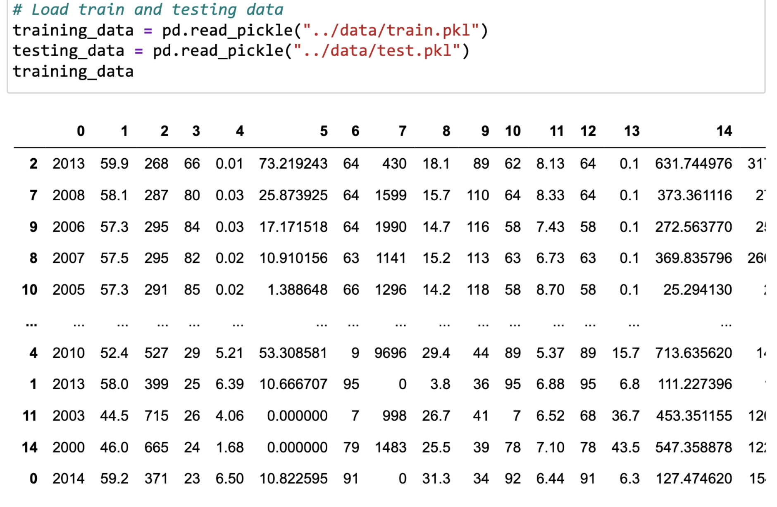

Slide 13
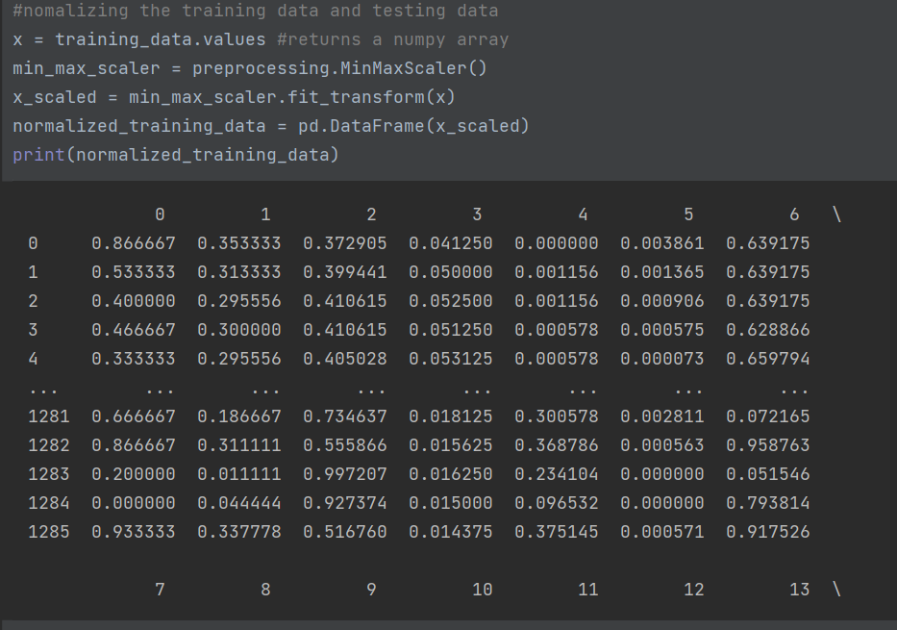
Nomalizing data

Slide 14
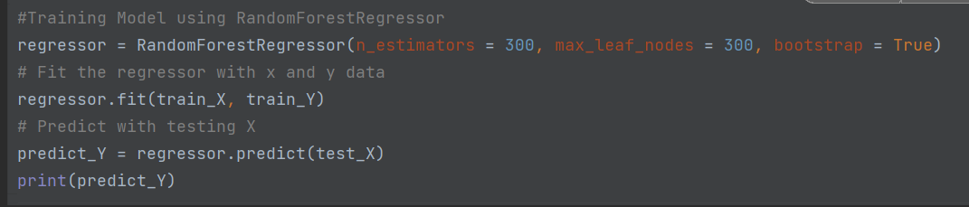
using model to train data

Slide 15
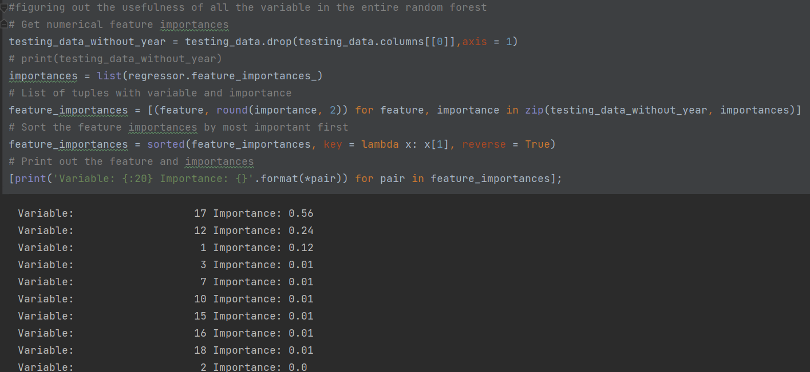
we calculate the importance of every feature

Slide 16
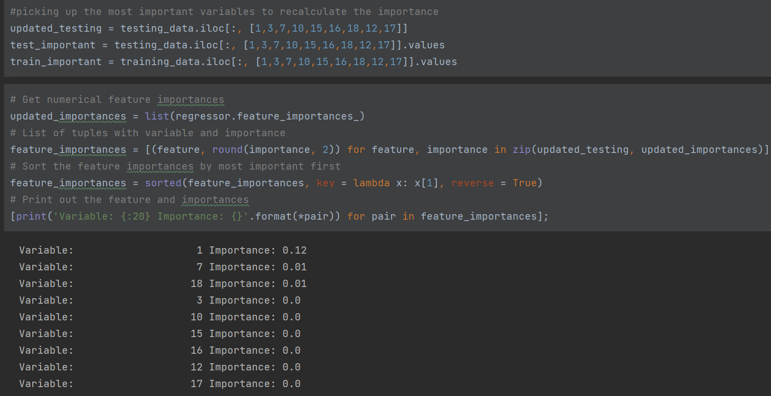
calculate the importance of updating testing data

Slide 17
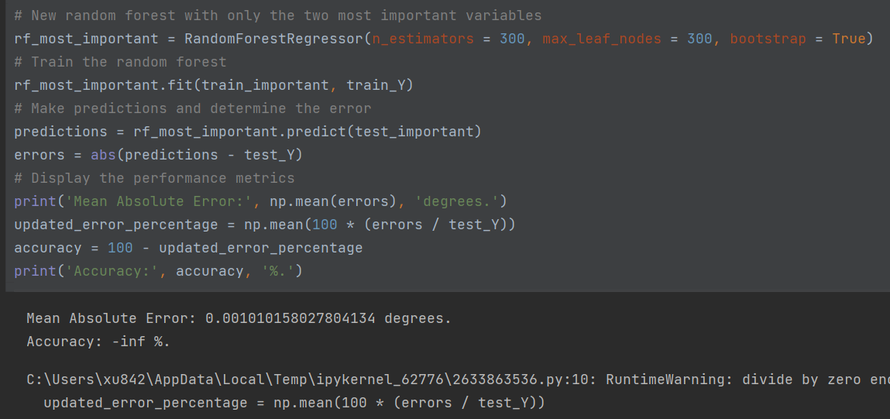

Slide 18
Results
Average difference on testing set: 0.7%
Average of (abs(predicted_y - actual_y) / actual_y)
Coefficient of determination R² (forest score): 0.95
Better accuracy the closer it is to 1
R² = (1 - u/v)
u defined as the residual sum of squares ((y_true - y_pred) ** 2).sum()
v defined as the total sum of squares ((y_true - y_true.mean()) ** 2).sum()
Notes:
Take the average loss of the regressor and yield a pretty good answer.

Slide 19
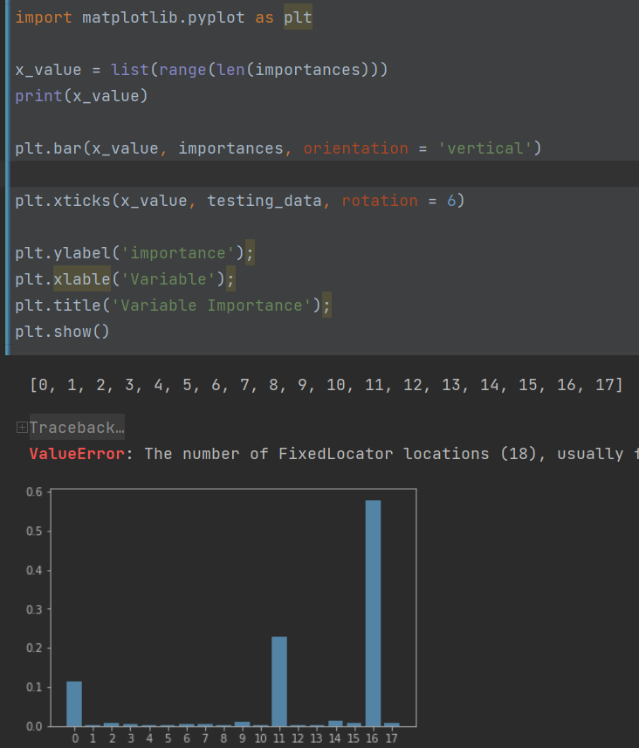
Results
most important features which influence the world:
Notes:
1%,10%,50%,100%增加相对比

Slide 20
Github link:
https://github.com/xu842251462/cs542FinalProject

Slide 21
Thanks you

